Slide 1
VOLLEY and GSON (MVVM pt. 2)
Advanced Native Mobile Programming Week 5 Teknik Informatika - Universitas Surabaya

Slide 2
PREVIOUSLY…
We learnt about MVVM architecture
We developed a sample app using MVVM, but using hardcoded data
We will try using live data from external DB

Slide 3
TOPIC
The Concept of Volley, GSON, API Endpoint
The Tutorial

Slide 4
THE CONCEPT
1
Volley, GSON, API Endpoint

Slide 5
VOLLEY LIBRARY
Volley is an HTTP library that makes networking for Android apps easier and most importantly, faster
Multiple concurrent network connections
Cancellation request API. You can cancel a single request, or you can set blocks or scopes of requests to cancel.
Source: https://developer.android.com/training/volley

Slide 6
GSON LIBRARY
Gson is a Java library that can be used to convert Java Objects into their JSON representation.
Provide simple toJson() and fromJson() methods to convert Java objects to JSON and vice-versa
Source: https://github.com/google/gson

Slide 7
@SerializedName ANNOTATIONS
It’s the way to map JSON fields with class fields respectively.
@SerializedName annotation indicates the annotated member should be serialized to JSON with the provided name value as its field name
Source : https://howtodoinjava.com/gson/gson-serializedname

Slide 8
API ENDPOINT
API Endpoint is one end of a communication channel
An endpoint can include a URL of a server or service
Each endpoint is the location from which APIs can access the resources they need to carry out their function
Source:
https://smartbear.com/learn/performance-monitoring/api-endpoints/

Slide 9
THE TUTORIAL
2
Implement the Volley with GSON

Slide 10
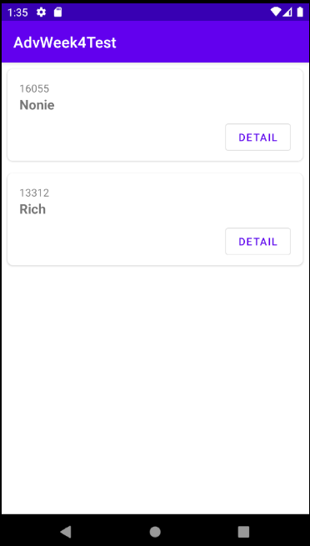
TUTORIAL GOALS
Implement volley library to replace hardcoded stuff
Using gson to map JSON data with class easily
Implement refresh layout action

Slide 11
VOLLEY NEEDS INTERNET
The first thing we must do is to add uses-permission of internet access
Open manifest and add the following codes:
<uses-permission android:name="android.permission.INTERNET"/>

Slide 12
INSPECT ENDPOINT
We use an external database for this tutorial, with an endpoint located at “http://adv.jitusolution.com/student.php”
Copy-paste the JSON output to jsonviewer.stack.hu to see JSON structure clearly

Slide 13
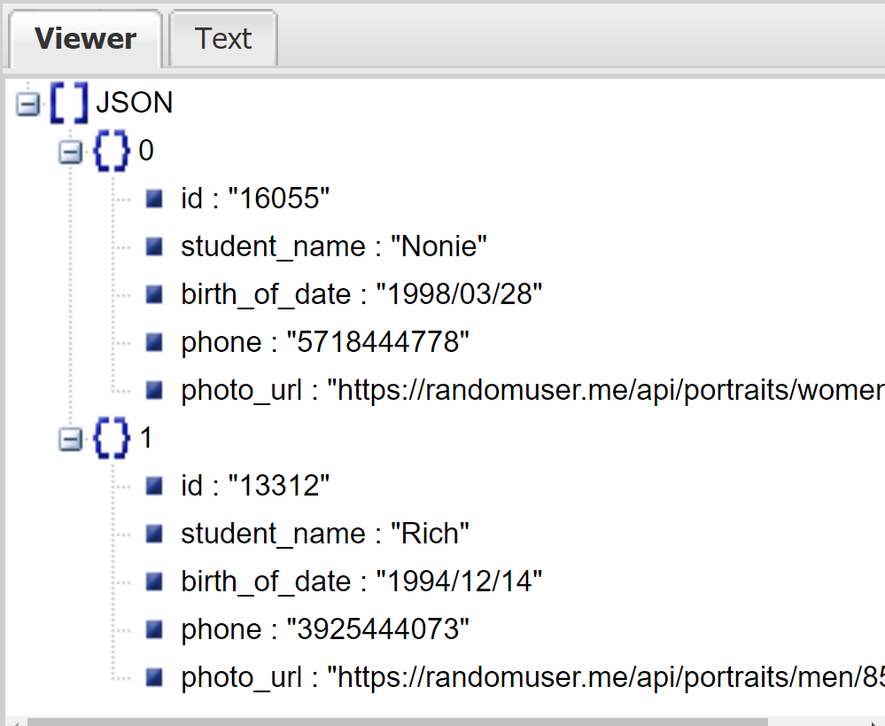
INSPECT ENDPOINT
As you notice, the structure has a similar field number and purpose as same as the Student class

Slide 14
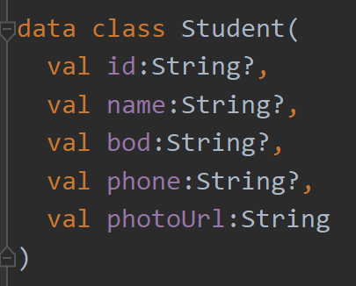
INSPECT ENDPOINT
However, some of field names are mismatch.

Slide 15
CLEAR TEXT TRAFFIC
Cleartext is any transmitted or stored information that is not encrypted or meant to be encrypted.
In this case, our endpoint doesn't use "HTTPS."
Android Oreo or above will consider this an illegal (not secure) transmission and immediately terminate your app.
To fix this (temporarily until we have https), add following manifest config in your <application> tag android:usesCleartextTraffic="true"

Slide 16
DEPENDENCIES
Add following GSON and Volley dependencies into your build.gradle (module) file (it’s a good idea to check for latest versions). Don’t forget to sync now implementation 'com.android.volley:volley:1.2.1'
implementation 'com.google.code.gson:gson:2.9.0'

Slide 17
CREATE VOLLEY
Open ListViewModel.kt
Create following to field/variable member: val TAG = "volleyTag" private var queue:RequestQueue? = null
TAG variable is useful later on volley request cancellation and delete everything inside refresh method

Slide 18
CREATE VOLLEY
Inside refresh method, set loading progress live data to true, and also the error to false
fun refresh() {
loadingLD.value = true
studentLoadErrorLD.value = false

Slide 19
CREATE VOLLEY
We encountered error here. Because volley request access to context object
Initialize volley
fun refresh() {
loadingLD.value = true
studentLoadErrorLD.value = false
queue = Volley.newRequestQueue( )
val url = "http://adv.jitusolution.com/student.php"

Slide 20
ANDROID VIEW MODEL
Thankfully, there is a subset of view model, called AndroidViewModel that have access to context object
Replace ViewModel with AndroidViewModel
class ListViewModel(application: Application): AndroidViewModel(application)

Slide 21
CREATE VOLLEY
Use getApplication() to access the context
fun refresh() {
loadingLD.value = true
studentLoadErrorLD.value = false
queue = Volley.newRequestQueue(getApplication())
val url = "http://adv.jitusolution.com/student.php"

Slide 22
CREATE VOLLEY
val stringRequest = StringRequest(
Request.Method.GET, url,
{
loadingLD.value = false
Log.d("showvoley", it)
},
{
Log.d("showvoley", it.toString())
studentLoadErrorLD.value = false
loadingLD.value = false
})
If success, we set loading progress live data to false
If failed, we show error message (set error live data to true), and set progress live data to false

Slide 23
JSON PARSE
In Native Mobile Programming course, we parse JSON manually by using JSONArray or JSONObject
This solution needs extra precision and prone to error
Solution: use GSON as way to serialize between Student class and JSON field

Slide 24
SERIALIZED NAME
As explained early, that there are some of mismatch field name between Student class and JSON field name. To fix this we should add annotation GSON SerializedName
data class Student(
val id:String?,
@SerializedName("student_name")
val name:String?,
@SerializedName("birth_of_date")
val bod:String?,
val phone:String?,
@SerializedName("photo_url")
val photoUrl:String
)
Not all field should be serialized. Field that different than JSON should be serialized

Slide 25
READ JSON
TypeToken used to retrieve the object type of list of student
{
val sType = object : TypeToken<List<Student>>() { }.type
val result = Gson().fromJson<List<Student>>(it, sType)
studentsLD.value = result
loadingLD.value = false
Log.d("showvoley", result.toString())
}
fromJson will convert JSON string into List of Student
And update the Student Live Data variable which is being observed by Student List Fragment

Slide 26
QUEUE ADD
Finally start the Volley Queue request and set the Tag
stringRequest.tag = TAG
queue?.add(stringRequest)

Slide 27
CLEAR THE QUEUE
We need to clean up code (volley resource) to prevent memory leak problems. Especially when the request still running but the observer is no longer observing the live data (view model)
Override onCleared and add following codes:
override fun onCleared() {
super.onCleared()
queue?.cancelAll(TAG)
}
Cancel all request that identified by TAG

Slide 28
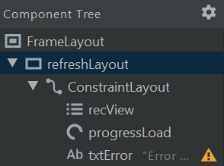
IMPLEMENT SWIPE REFRESH ACTION
Open the fragment_student_list.xml
Set id for SwipeRefreshLayout to “refreshLayout”

Slide 29
IMPLEMENT SWIPE REFRESH ACTION
Next, open the StudentListFragment.kt, and add following codes inside the onViewCreated method
refreshLayout.setOnRefreshListener {
recView.visibility = View.GONE
txtError.visibility = View.GONE
progressLoad.visibility = View.VISIBLE
viewModel.refresh()
refreshLayout.isRefreshing = false
}
This listener triggered when user do vertical swipe on the layout.
It loads up the viewmodel to retrieve latest data from endpoint api
This simply hide the loading progress icon

Slide 30
RESULT
ViewModel now have access to external database. Update the live data.

Slide 31
THANKS!
Any questions?
You can find me at
andre@staff.ubaya.ac.id

